Slide 1
Happy Life

Slide 2
Objectives
Selection of part affected
Selection of symptoms
Detection of disease
Recommending a specialist

Slide 3
Happy Life
Happy life is a medibot particularly designed for a temporary diagnosis of a disease for various purposes.
This helps in detection of a particular disease with respect to the symptoms.
This even recommends a specialist to get treatment from.

Slide 4
Specifications
This mainly supports people in emergency cases, people in far away places who are away from medical support etc

Slide 5
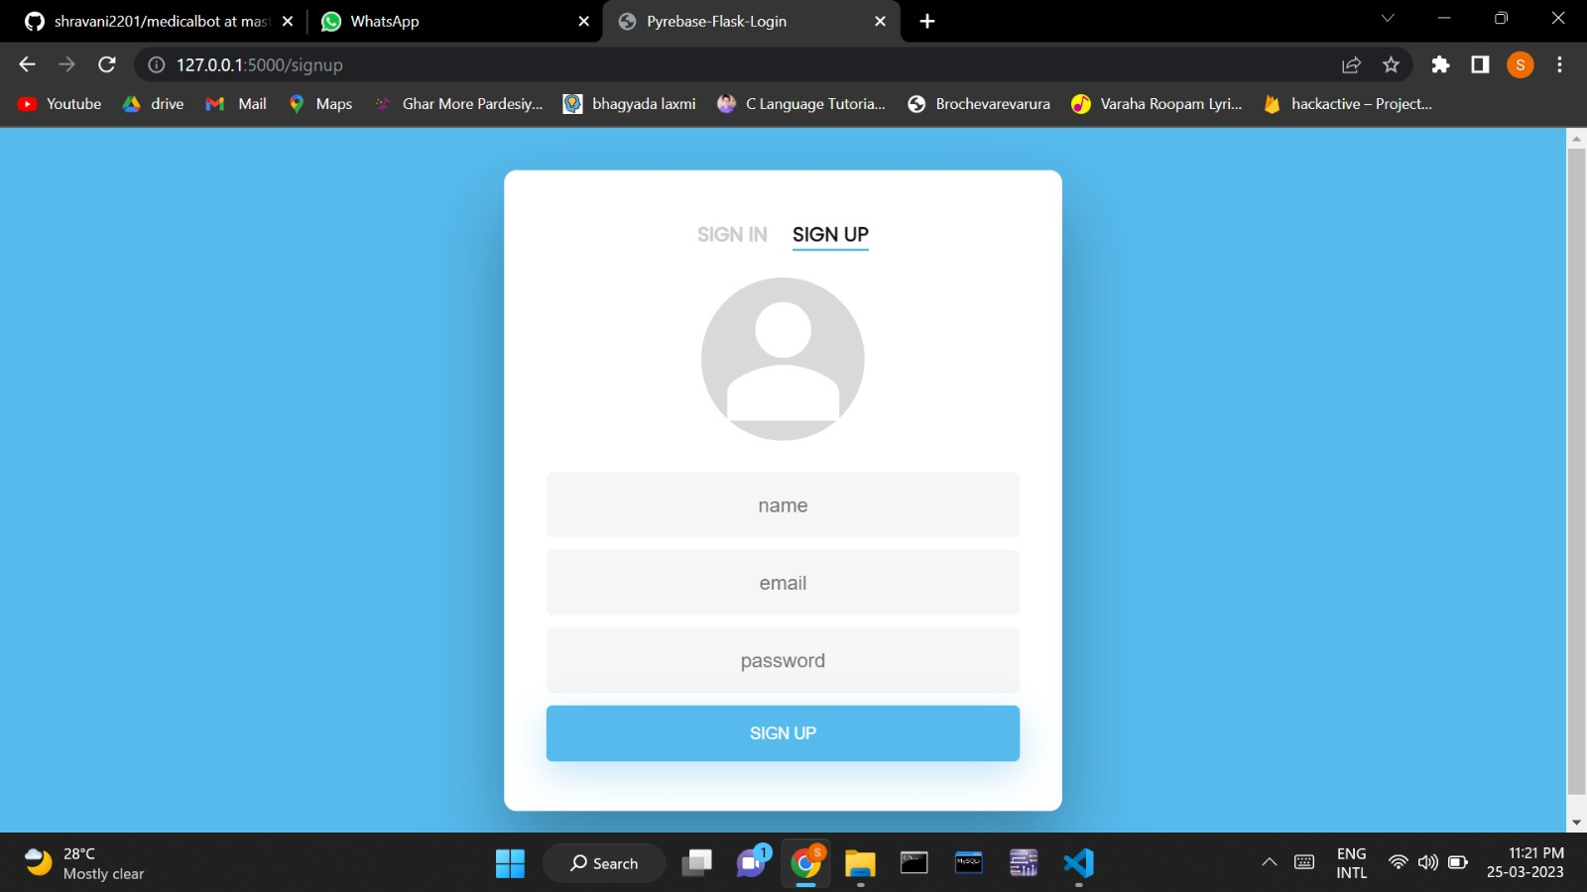
Working
Sign up for user

Slide 6
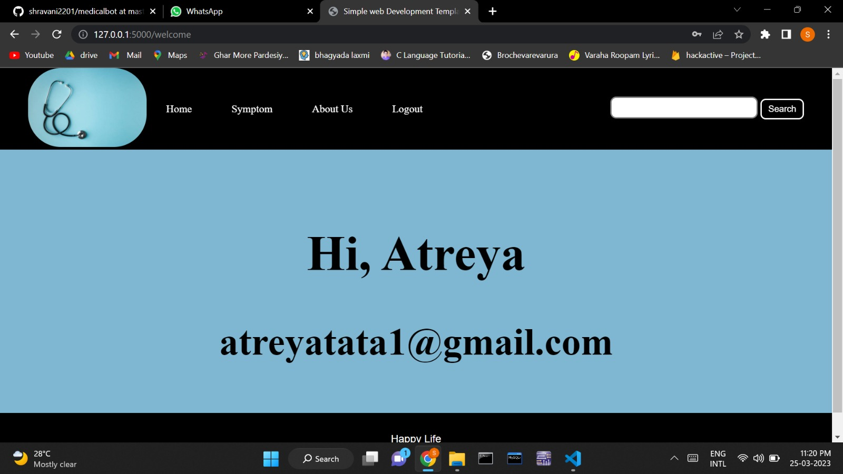
Welcome page

Slide 7
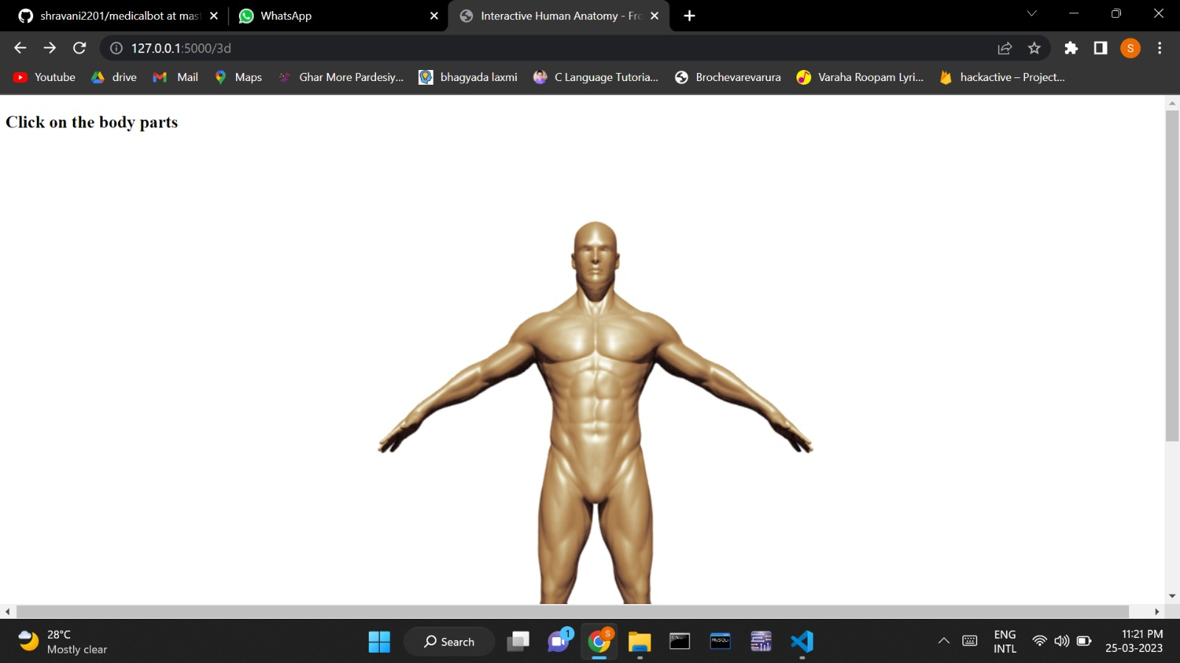
Selection of affected part

Slide 8
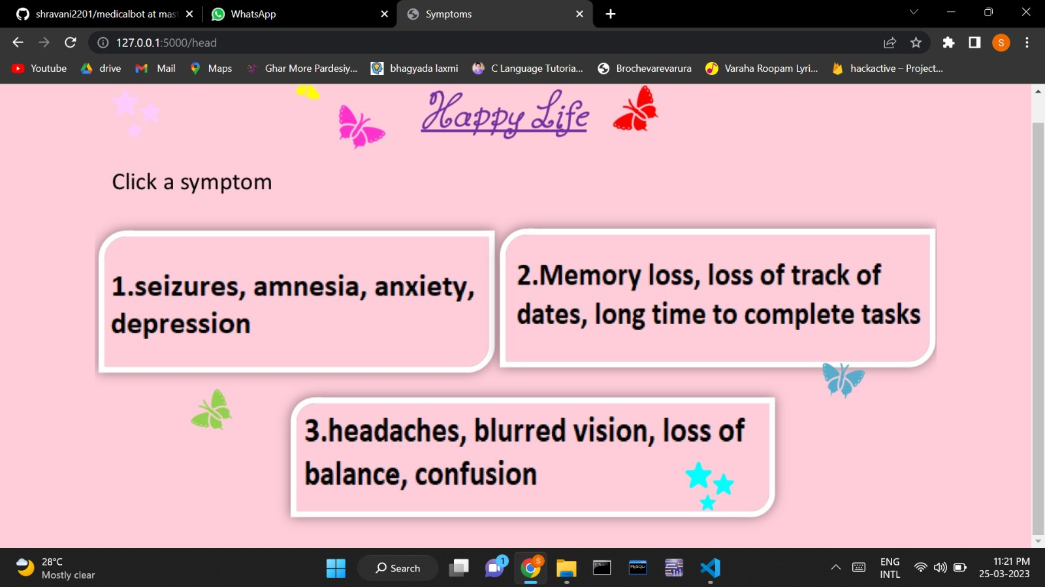
Selection of Symptoms

Slide 9
Final Stage
Then the disease you are suffering from appears along with the specialist you have to take advise from.

